Slide 1
Deploying to Production
Pravin Y Pawar
Adapted from “Introducing MLOps”
By Mark Treveil and Dataiku Team

Slide 2
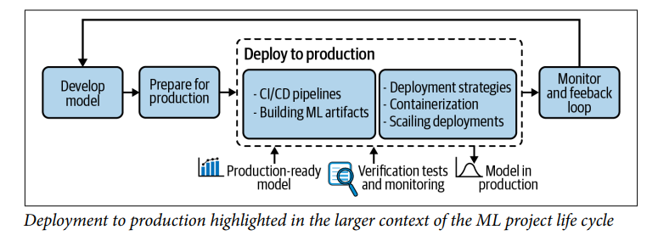
Deploying to Production
Business leaders view rapid deployment of systems into production as key to maximizing business value
only true if deployment can be done smoothly and at low risk
Lets dive into the concepts and considerations when deploying machine learning models to production
that impact and drive—the way MLOps deployment processes are built

Slide 3
CI/CD Pipelines
A common acronym for continuous integration and continuous delivery (or put more simply, deployment)
Forms a modern philosophy of agile software development and a set of practices and tools
to release applications more often and faster, while also better controlling quality and risk
Ideas are decades old and already used to various extents by software engineers
different people and organizations use certain terms in very different ways
Essential to keep in mind that
these concepts should be tools to serve the purpose of delivering quality fast
first step is always to identify the specific risks present at the organization
CI/CD methodology should be adapted based on the needs of the team and the nature of the business.

Slide 4
CI/CD for ML
CI/CD concept apply just as well to machine learning systems
are a critical part of MLOps strategy
An example of such pipeline could be:
1. Build the model
a. Build the model artifacts
b. Send the artifacts to long-term storage
c. Run basic checks (smoke tests/sanity checks)
d. Generate fairness and explainability reports
2. Deploy to a test environment
a. Run tests to validate ML performance, computational performance
b. Validate manually
3. Deploy to production environment
a. Deploy the model as canary
b. Fully deploy the model

Slide 5
CI/CD for ML(2)
Many scenarios are possible, depend on the application,
the risks from which the system should be protected
and the way the organization chooses to operate
Generally, an incremental approach to building a CI/CD pipeline is preferred:
a simple or even naïve workflow on which a team can iterate
often much better than starting with complex infrastructure from scratch
A starting project does not have the infrastructure requirements of a tech giant
can be hard to know up front which challenges deployments will present
There are common tools and best practices,
but there is no one-size-fits-all CI/CD methodology
means the best path forward is starting from a simple (but fully functional) CI/CD workflow
then introducing additional or more sophisticated steps along the way as quality or scaling challenges appear

Slide 6
Building ML Artifacts
The goal of a continuous integration pipeline is
to avoid unnecessary effort in merging the work from several contributors
also to detect bugs or development conflicts as soon as possible
The very first step is using centralized version control systems
unfortunately, working for weeks on code stored only on a laptop is still quite common
The most common version control system is Git, an open source software
majority of software engineers across the world already use Git,
increasingly being adopted in scientific computing and data science
Git allows for
maintaining a clear history of changes,
safe rollback to a previous version of the code,
multiple contributors to work on their own branches of the project before merging to the main branch, etc
Git is appropriate for code, but not designed
to store other types of assets common in data science workflows,
such as large binary files (for example, trained model weights),
or to version the data itself

Slide 7
ML Artifact
Once code and data is in a centralized repository,
a testable and deployable bundle of the project must be built
are usually called artifacts in the context of CI/CD
Each of the following elements needs to be bundled into an artifact
that goes through a testing pipeline and is made available for deployment to production:
Code for the model and its preprocessing
Hyperparameters and configuration
Training and validation data
Trained model in its runnable form
An environment including libraries with specific versions, environment variables, etc.
Documentation
Code and data for testing scenarios

Slide 8
The Testing Pipeline
Testing pipeline can validate a wide variety of properties of the model contained in the artifact
good tests should make it as easy as possible to diagnose the source issue when they fail
Automating tests as much as possible is essential and is a key component of efficient MLOps
A lack of automation or speed wastes time,
also discourages the development team from testing and deploying often,
which can delay the discovery of bugs or design choices that make it impossible to deploy to production

Slide 9
Deployment concepts
Integration
Process of merging a contribution to a central repository and performing more or less complex tests
typically merging a Git feature branch to the main branch
Delivery
Same as used in the continuous delivery (CD) part of CI/CD,
Process of building a fully packaged and validated version of the model ready to be deployed to production
Deployment
Process of running a new model version on a target infrastructure
Fully automated deployment is not always practical or desirable
Release
In principle, release is yet another step, directing production workload to model
deploying a model version (even to the production infrastructure) does not necessarily mean that the production workload
is directed to the new version
multiple versions of a model can run at the same time on the production infrastructure

Slide 10
Categories of Model Inferences
Two ways to approach model deployment
Batch scoring,
where whole datasets are processed using a model, such as in daily scheduled jobs
Real-time scoring,
where one or a small number of records are scored,
such as when an ad is displayed on a website and a user session is scored by models to decide what to display
In both cases, multiple instances of the model can be deployed
to increase throughput and potentially lower latency

Slide 11
Considerations When Sending Models to Production
When sending a new model version to production, first consideration is often to avoid downtime,
in particular for real-time scoring
Blue-green or red-black— deployment
basic idea is that rather than shutting down the system, upgrading it, and then putting it back online,
a new system can be set up next to the stable one
and when it’s functional, the workload can be directed to the newly deployed version
and if it remains healthy, the old one is shut down
Canary deployment
idea is that the stable version of the model is kept in production,
but a certain percentage of the workload is redirected to the new model, and results are monitored
usually implemented for real-time scoring, but a version of it could also be considered for batch

Slide 12
Maintenance in Production
Once a model is released, it must be maintained
At a high level, there are three maintenance measures:
Resource monitoring
Health check
ML metrics monitoring
Resource monitoring
Just as for any application running on a server, collecting IT metrics such as CPU, memory, disk, or network usage
can be useful to detect and troubleshoot issues
Health check
Need to check if the model is indeed online and to analyze its latency
simply queries the model at a fixed interval (on the order of one minute) and logs the results
ML metrics monitoring
about analyzing the accuracy of the model and comparing it to another version or detecting when it is going stale
may require heavy computation, this is typically lower frequency
Finally, when a malfunction is detected, a rollback to a previous version may be necessary
critical to have the rollback procedure ready and as automated as possible;
testing it regularly can make sure it is indeed functional

Slide 13
Thank You!
In our next session:

